Slide 1
Where Are The
9
Luke 17:11-19
Richard Thetford www.thetfordcountry.com

Slide 2
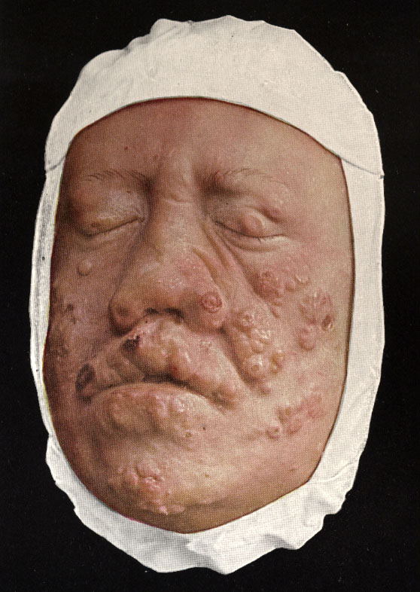
Ten Lepers Healed
Leprosy
Incurable by man
Sin separates us from God
Isaiah 59:1-2
Ten lepers cried for mercy
Jesus had the power to heal
Hebrews 7:25
Test of their faith
Richard Thetford www.thetfordcountry.com

Slide 3
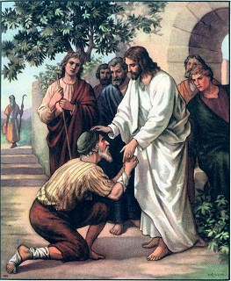
The Facts
One showed gratitude
All had the same disease
All had the same condition
All came to the same person
All cried for the same thing
All told to do the same thing
All received the same blessing
Only ONE returned – a Samaritan!
Richard Thetford www.thetfordcountry.com

Slide 4
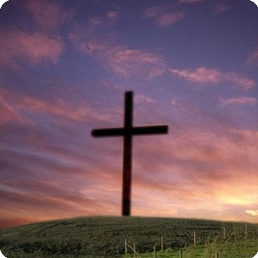
We Should Be Thankful For
Names written in heaven
Revelation 21:27
Luke 10:20
Salvation
Romans 6:17-23
God sent His Son to die for us
Romans 5:8
Hebrews 2:9
Richard Thetford www.thetfordcountry.com

Slide 5
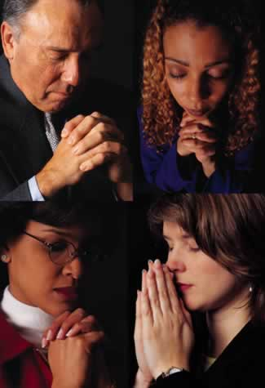
We Should Be Thankful For
Temporal things we have
Colossians 2:6-7
Philippians 4:19
Mark 8:6-7
Christian fellowship
2 Thessalonians 1:3
All things
Ephesians 5:20
Richard Thetford www.thetfordcountry.com

Slide 6
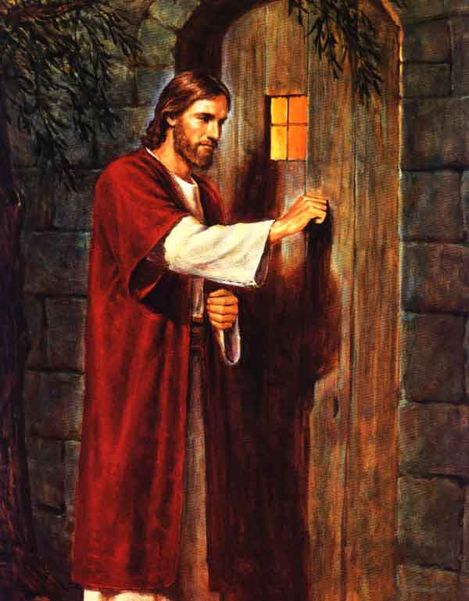
Conclusion
The results of ingratitude:
Romans 1:20-25
Be mindful of our blessings and thank God for them!
“Behold, I stand at
the door and knock”
Richard Thetford www.thetfordcountry.com

