Slide 1
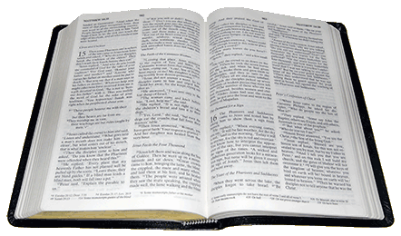
FAITHFULNESS
1 Corinthians 15:58
Richie Thetford www.thetfordcountry.com

Slide 2
Committing to Faithfulness
Count the cost
Luke 14:27-33
Don’t look back
Luke 8:13; Luke 9:62
Hebrews 10:38-39
Understand the results of failure
2 Peter 2:20-22
Hebrews 10:26-27; 6:4-6
Richie Thetford www.thetfordcountry.com

Slide 3
Continuing in Faithfulness
Active engagement in worship
Hebrews 10:23-25
Studying the Bible
Acts 17:11
Imitating Christ
Philippians 2:5-8
Richie Thetford www.thetfordcountry.com

Slide 4
Concern for Faithfulness
Encourage the weak
Jude 22; Romans 15:1-2; 1 Thessalonians 5:14
Exhort the strong
1 Corinthians 10:1-12; Hebrews 3:12-13; 2 Peter 1:12-13
Retrieve the wayward
James 5:19-20; Galatians 6:1; Jude 20-23
Richie Thetford www.thetfordcountry.com

Slide 5
Company of Faithfulness
Remain true to the Word
1 John 1:3-7; Acts 2:42
Benefits of fellowship
Hebrews 10:25; Galatians 2:9
Barriers of fellowship
1 Corinthians 5:9-13
2 Thessalonians 3:6
Romans 16:17
Richie Thetford www.thetfordcountry.com

Slide 6
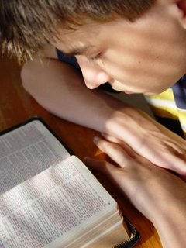
We must go back to the Bible pattern of faithfulness:
In our commitment to faithfulness
In our continuance in faithfulness
In our concern for faithfulness
In the company of faithfulness
Richie Thetford www.thetfordcountry.com

