Slide 1
Richie Thetford thetfordcountry.com

Slide 2
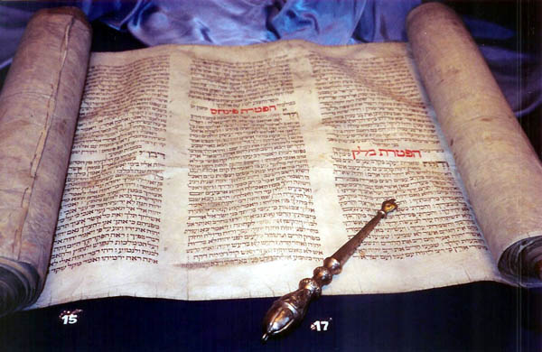
Israel Required to Read God’s Law
Law of Moses written and read
Exodus 19:1-6
Exodus 24:3-7
Continued in New Testament times
Acts 13:14-15, 27
Acts 15:21
Luke 4:16-21
2 Corinthians 3:12-15
Richie Thetford thetfordcountry.com

Slide 3
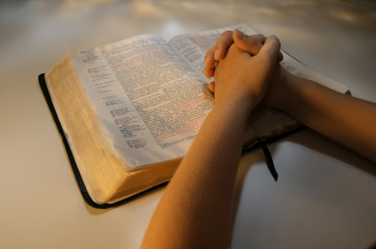
Israel’s Strength Depended on “Reading” God’s Law
Kings
Deuteronomy 17:14-20
Regular reading
Deuteronomy 31:9-13
Joshua
Joshua 8:30-35
Ezra and Nehemiah
Nehemiah 8:1-13, 18
Richie Thetford thetfordcountry.com

Slide 4
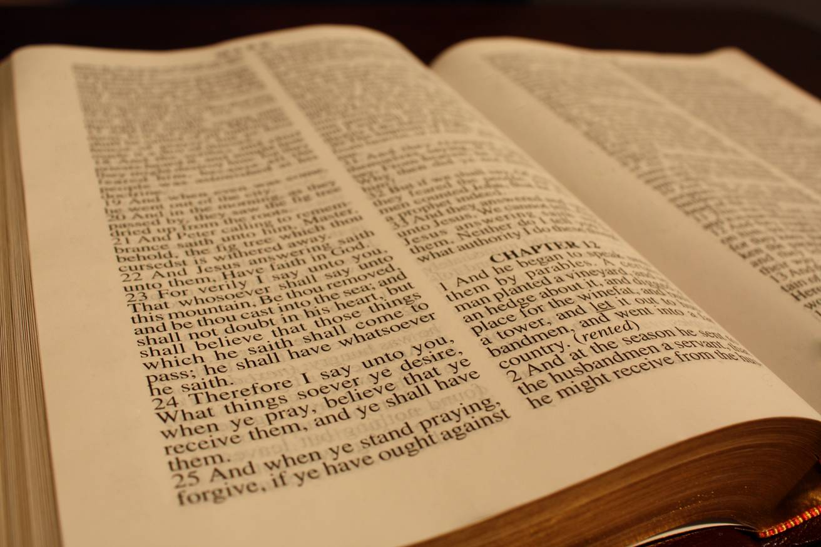
Jesus Encouraged “Reading”
Bible passages
Matthew 12:3-5
Matthew 19:4
Matthew 21:16, 42
Matthew 22:31
Temptation of Jesus
Matthew 4:4, 7, 10
Jesus taught a lawyer
Luke 10:25-28
Richie Thetford thetfordcountry.com

Slide 5
Apostles and Prophets – “Reading”
Old Testament prophecies
Acts 17:10-11
Instructions of Paul
Ephesians 3:4
Colossians 4:16
1 Thessalonians 5:27
Reading the Bible is necessary for all!
Richie Thetford thetfordcountry.com

Slide 6
Salvation Depends on “Reading”
Salvation
1 Timothy 4:12-15
Romans 1:15-17
John 20:30-31
Romans 10:17
2 Corinthians 5:7
Richie Thetford thetfordcountry.com

Slide 7
Salvation Depends on “Reading”
The saving of our children
2 Timothy 1:3-5
2 Timothy 3:14-15
Ephesians 6:4
Defending the gospel
2 Timothy 3:10-17
2 Timothy 2:14-18
Richie Thetford thetfordcountry.com

Slide 8
Is reading the Bible a TOP priority in our life?
Richie Thetford thetfordcountry.com

