Slide 1
Taking Responsibility For Our Actions
“Therefore, do not let sin reign in your mortal body, that you should obey it in its lusts” Romans 6:12
Richie Thetford www.thetfordcountry.com

Slide 2
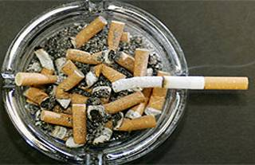
Introduction
Few are willing to accept responsibility for their actions
Smoker: “can’t quit”
Gambler: “addicted”
Adulterer: “driven to it”
Homosexual: “born that way”
Murderer: “temporarily insane”
Offenders are no longer sinful or criminal, but sick
Richie Thetford www.thetfordcountry.com

Slide 3
Introduction
We in the church have not been unaffected
Need for repentance is often obscured by the notion that we can’t change without therapeutic “help”
David: “I have sinned against the Lord”
Replaced by “I can’t help myself”
Jesus: “Go and sin no more”
Replaced by “Go and join a support group”
Richie Thetford www.thetfordcountry.com

Slide 4
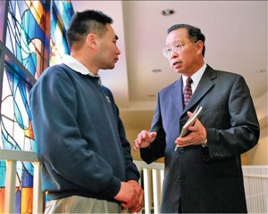
Responsible For Our Own Sins
May be influenced by others – but responsible for our sins
“Fathers shall not be put to death for their children, nor shall children be put to death for their fathers; a person shall be put to death for his own sin.” Deuteronomy 24:16
“The soul who sins shall die. The son shall not bear the guilt of the father, nor the father bear the guilt of the son. The righteousness of the righteous shall be upon himself, and the wickedness of the wicked shall be upon himself.” Ezekiel 18:20
Richie Thetford www.thetfordcountry.com

Slide 5
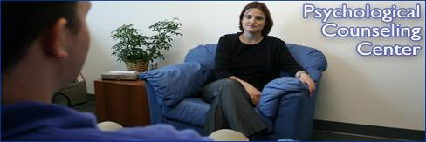
Responsible For Our Own Sins
We tend to blame mis-conduct on four things
Heredity
Environment
Biochemistry
Psychological “disorders”
We have “medicalized” many misbehaviors that have little or no medical component
Richie Thetford www.thetfordcountry.com

Slide 6
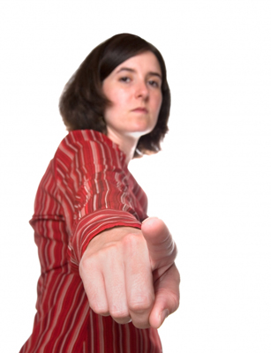
Responsible For Our Own Sins
We think in terms of bad things happening to us, rather than in terms of what we do of our own volition
Adam and Eve (Genesis 3:12-13)
Trying to have our “responsibility” cake and eat it, too
Franklin Jones: “Be thankful for bad luck. Without it, you’d have to blame yourself.”
Richie Thetford www.thetfordcountry.com

Slide 7
Responsibility Cannot Be Separated From Free Moral Agency
William Lee Wilbanks: “The New Obscenity”
“It’s not a four-letter word, but an oft-repeated statement that strikes at the very core of our humanity. The four words are: “I can’t help myself” …. By ignoring the idea that people face temptations that can – and should – be resisted, it denies the very quality that separates us from the animals.”
Richie Thetford www.thetfordcountry.com

Slide 8
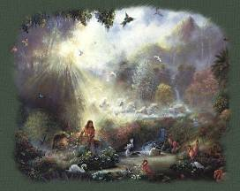
Responsibility Cannot Be Separated From Free Moral Agency
Human beings are subjects that act
“So God created man in His own image; in the image of God He created him; male and female He created them.” Genesis 1:27
“For You have made him a little lower than the angels, And You have crowned him with glory and honor. You have made him to have dominion over the works of Your hands; You have put all things under his feet, All sheep and oxen — Even the beasts of the field, The birds of the air, And the fish of the sea That pass through the paths of the seas.” Psalms 8:5-8
Richie Thetford www.thetfordcountry.com

Slide 9
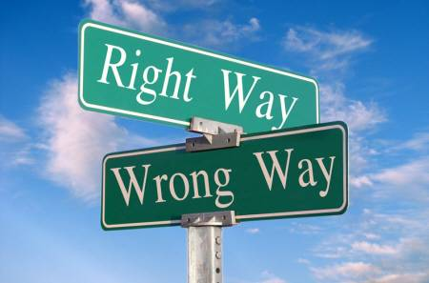
Considerations That Can Help Our Thinking
Some behaviors do come to involve medical factors and physical compulsions
These rarely arise if certain choices have not been made earlier
Drug addiction
Suicide
Smoking
“But put on the Lord Jesus Christ, and make no provision for the flesh, to fulfill its lusts.” Romans 13:14
Richie Thetford www.thetfordcountry.com

Slide 10
Considerations That Can Help Our Thinking
To say that a person has a unique “package of pressures” does not absolve him of personal responsibility
We all have pressures
Jesus had His own pressures
Luke 4:1-13
Anyone can do right when all factors are favorable to us – but Christ has called us to a higher standard!
Richie Thetford www.thetfordcountry.com

Slide 11
Considerations That Can Help Our Thinking
Basically, there are two boxes to check:
I AM RESPONSIBLE
I AM NOT RESPONSIBLE
God will decide what goes in which box
He knows that He made us capable of resisting much stronger temptations than we sometimes admit
Philippians 4:13; 1 Corinthians 10:13
Richie Thetford www.thetfordcountry.com

Slide 12
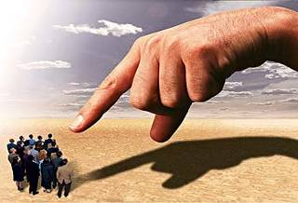
Considerations That Can Help Our Thinking
In God’s judgment of accountable persons, there are only two groups:
The responsible good
The responsible evil
Romans 2:6-11
“For we must all appear before the judgment seat of Christ, that each one may receive the things done in the body, according to what he has done, whether good or bad.” 2 Corinthians 5:10
Richie Thetford www.thetfordcountry.com

Slide 13
Conclusion
Satan would like us to believe that we are helpless – nothing sinful is our fault!
We do not have to be the passive victims of sin
Our behavior ought to be the result of our decisions, not our conditions
We NEVER have to sin
James 1:12-16
Richie Thetford www.thetfordcountry.com

Slide 14
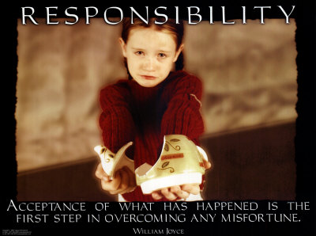
Conclusion
Outside sources might help, but what we really need is Jesus Christ!
“Therefore, do not let sin reign in your mortal body, that you should obey it in its lusts” Romans 6:12
When we do mess up, make mistakes, and sin – don’t blame others or things, but rather accept what we have done as wrong and ask God to forgive us
Richie Thetford www.thetfordcountry.com

