Slide 1
Let Us Bow Down!
Richie Thetford www.thetfordcountry.com

Slide 2
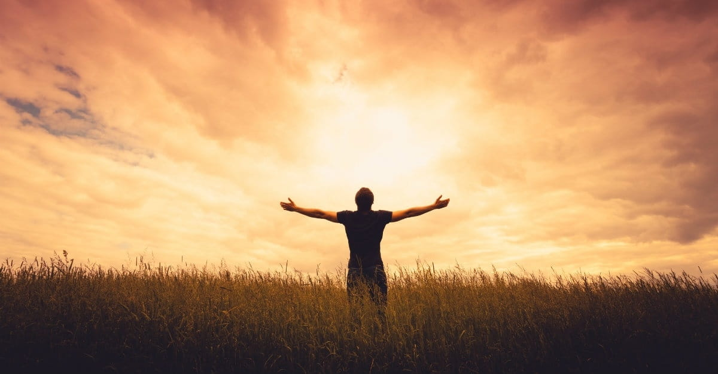
Why Do We Worship?
He is our God
Psalms 95:7
He made us
Psalms 100:3
Genesis 1:26
He loved us
Romans 5:6-8
Richie Thetford www.thetfordcountry.com

Slide 3
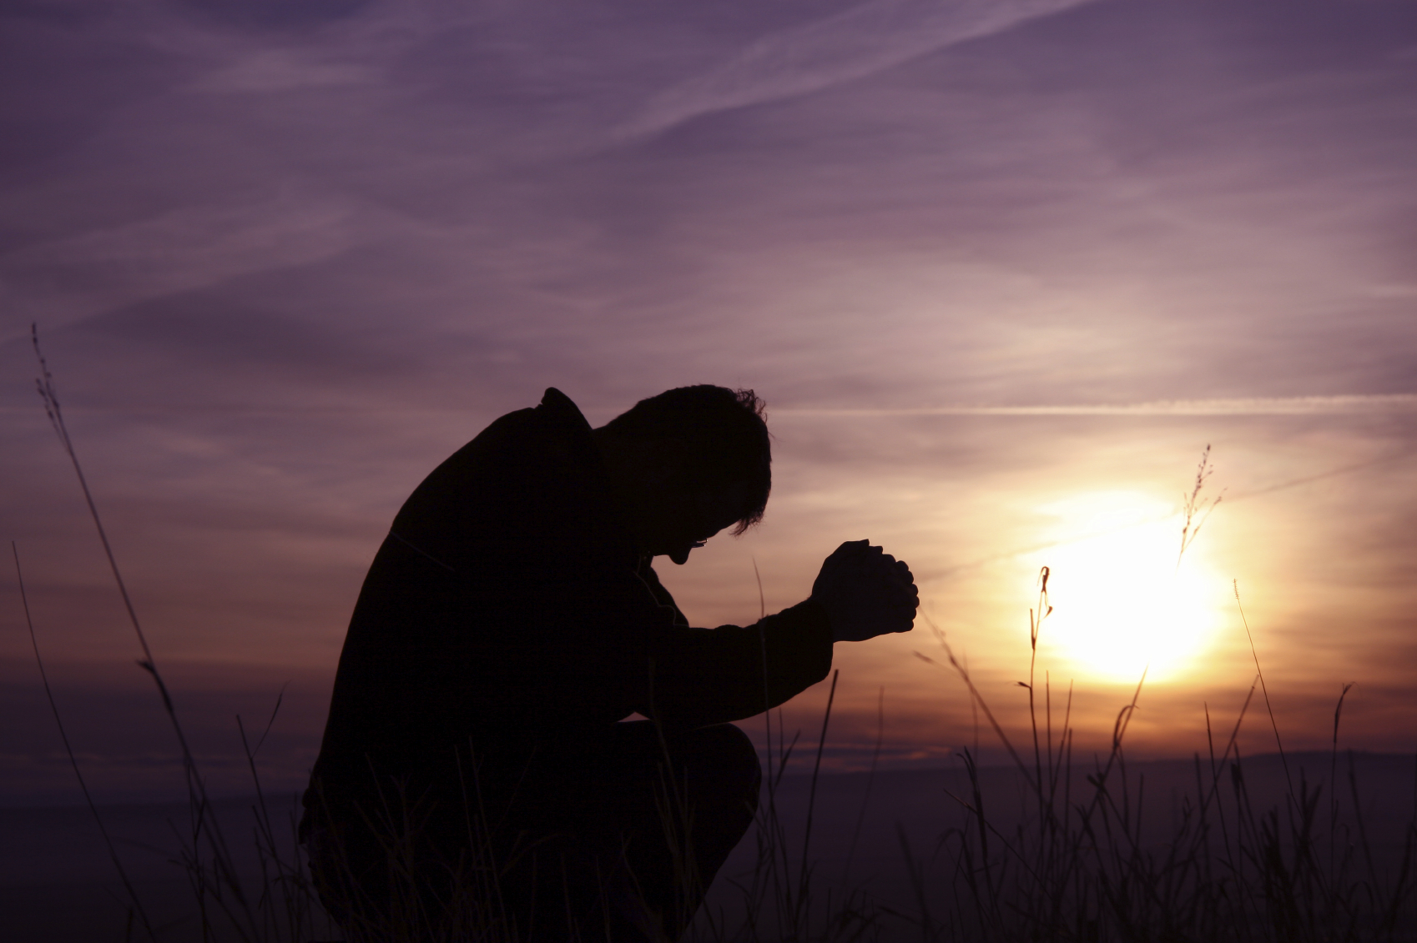
Why Do We Worship?
He deserves our reverence
Ecclesiastes 12:13-14
He must be counted as Holy
Leviticus 10:1-3
Richie Thetford www.thetfordcountry.com

Slide 4
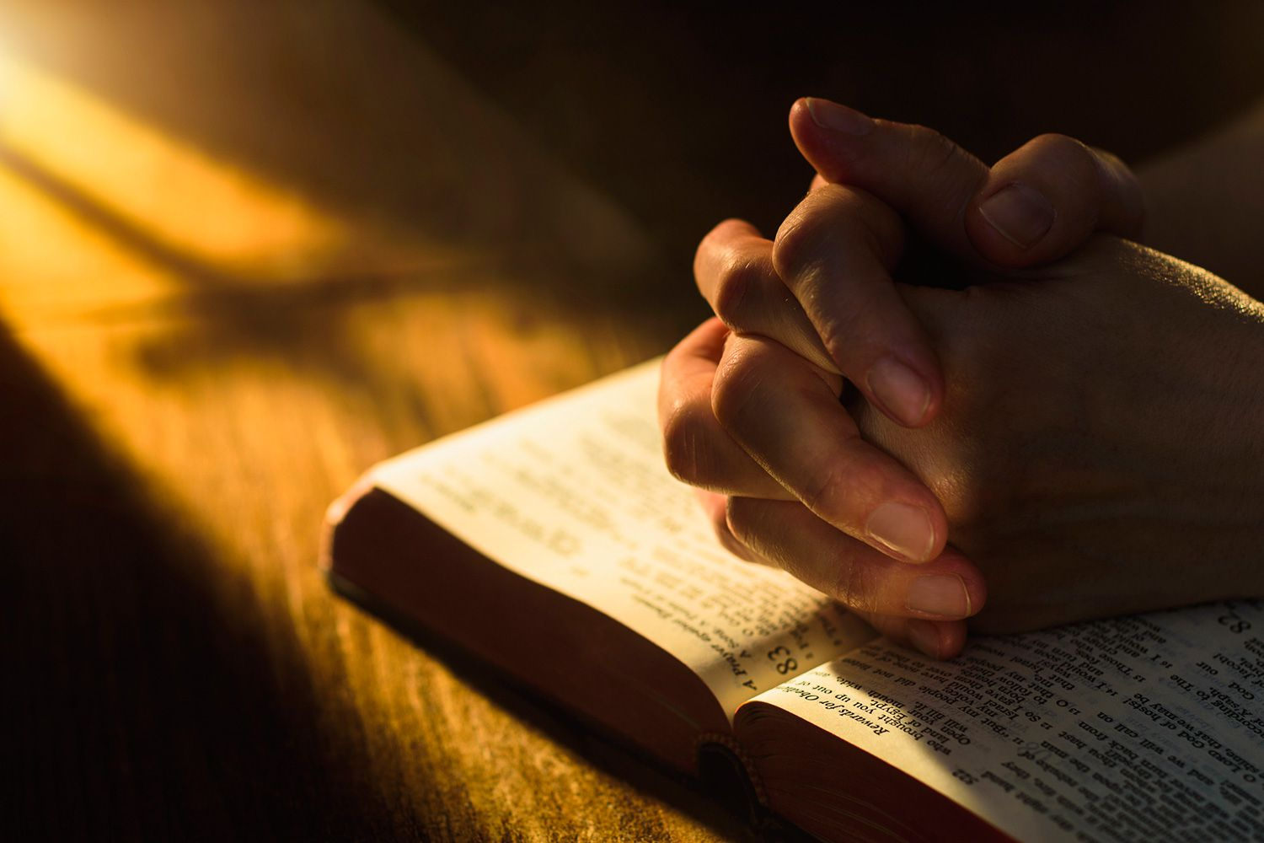
What Worship Is
We bow down before Him
Psalms 95:6
We exalt Him
Psalms 99:5, 9
We give Him the glory
Psalms 29:1-2
Richie Thetford www.thetfordcountry.com

Slide 5
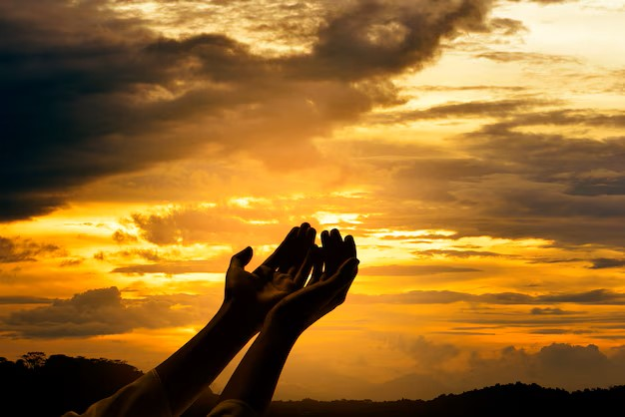
What Worship Is
Praise Him!
Psalms 146:1-2
Hebrews 13:15
1 Peter 2:5
Richie Thetford www.thetfordcountry.com

Slide 6
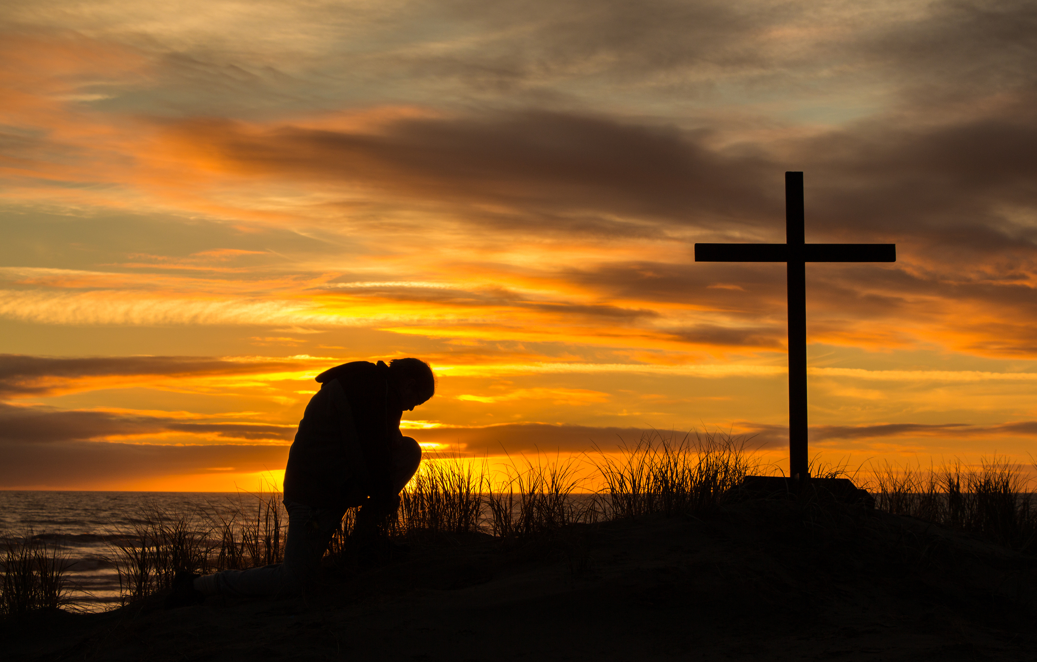
True Worship Today
More than an emotion
John 4:23-24
From our heart
Matthew 15:7-9
Remember and proclaim Him
1 Corinthians 11:23-26
Richie Thetford www.thetfordcountry.com

Slide 7
True Worship Today
To admonish one another
Colossians 3:16
Richie Thetford www.thetfordcountry.com

Slide 8
Conclusion
Worship is NOT about us
Worship springs from a grateful heart
Jesus calls us to come to Him
“Come to Me, all you who labor and are heavy laden, and I will give you rest. Take My yoke upon you and learn from Me, for I am gentle and lowly in heart, and you will find rest for your souls. For My yoke is easy and My burden is light.”
Matthew 11:28-30
Richie Thetford www.thetfordcountry.com

