Slide 1
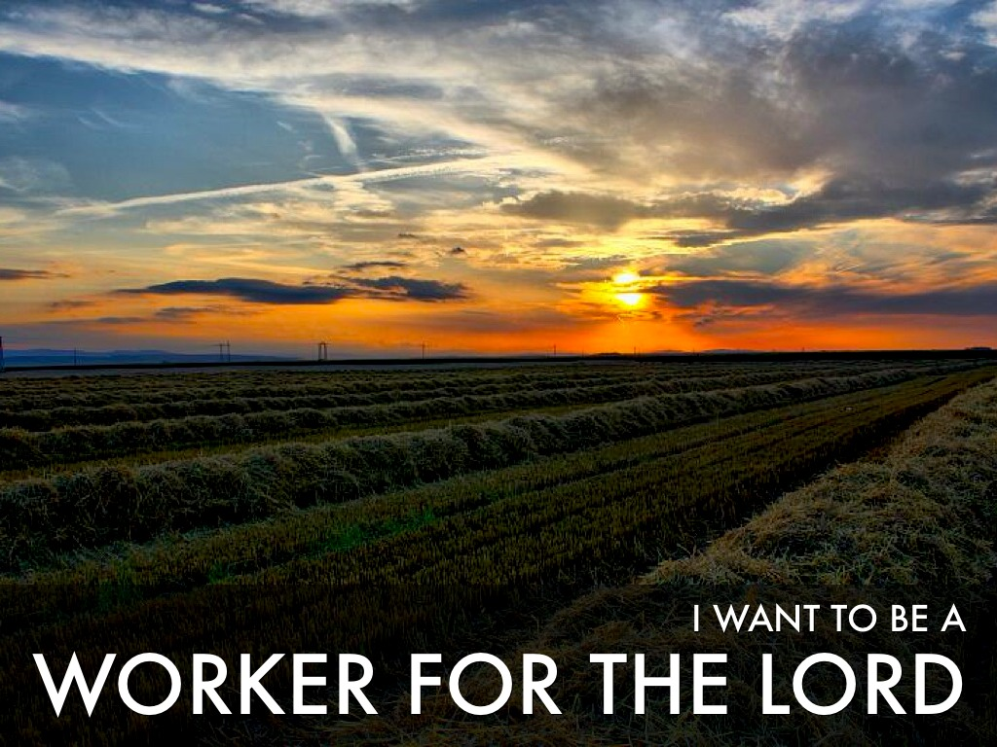
2 Corinthians 13:5-8
Romans 10:17
2 Timothy 2:15
James 2:24
John 15:5
Richie Thetford www.thetfordcountry.com

Slide 2
Laborers in the Vineyard
A valuable lesson learned concerning our work
Matthew 20:1-16
The householder went out to HIRE laborers
The householder went out to hire LABORERS
The householder went out to hire laborers into HIS VINEYARD
Jesus wants VOLUNTEERS to WORK in HIS VINEYARD
Richie Thetford www.thetfordcountry.com

Slide 3
The Preacher
Things a preacher should do
Pray – 1 Thessalonians 5:17
Study – 2 Timothy 2:15
Live what he teaches – 1 Timothy 4:12
Looking out for the salvation of others – James 5:19-20
Know the truth – John 8:32
Check on those who are ill – Matthew 25:31-46
Richie Thetford www.thetfordcountry.com

Slide 4
The Preacher
Things a preacher should do
Grow in the faith – Hebrews 11:6
Keep his individual responsibility – Matthew 6:20
Gain zeal for God as he grows – 2 Peter 1:5-8
Does unto others as he would have others do unto him – Matthew 7:12
All of these things are ALSO the work and responsibility of every Christian
Richie Thetford www.thetfordcountry.com

Slide 5
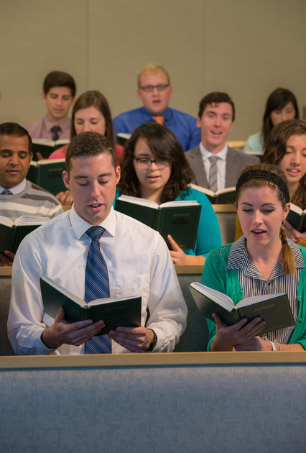
The Responsible Work of Each Member
Being a present church member
Hebrews 10:25
Being a cooperating church member
Romans 12:10
Being a sympathetic church member
Romans 12:15-16
Richie Thetford www.thetfordcountry.com

Slide 6
The Responsible Work of Each Member
Being a sincere church member
Romans 12:11
Being a contributing church member (in all ways)
Romans 12:8
Being a growing church member
2 Peter 3:18
Richie Thetford www.thetfordcountry.com

Slide 7
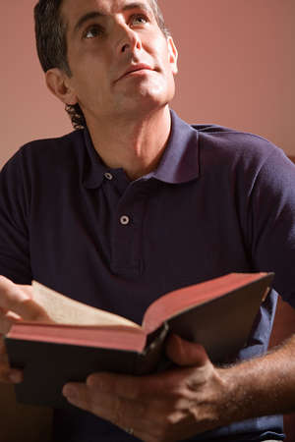
The Responsible Work of Each Member
Being a studying church member
Acts 17:11
Being a constant church member
1 Corinthians 15:58
Being a sacrificial church member
Romans 12:1-2
Richie Thetford www.thetfordcountry.com

Slide 8
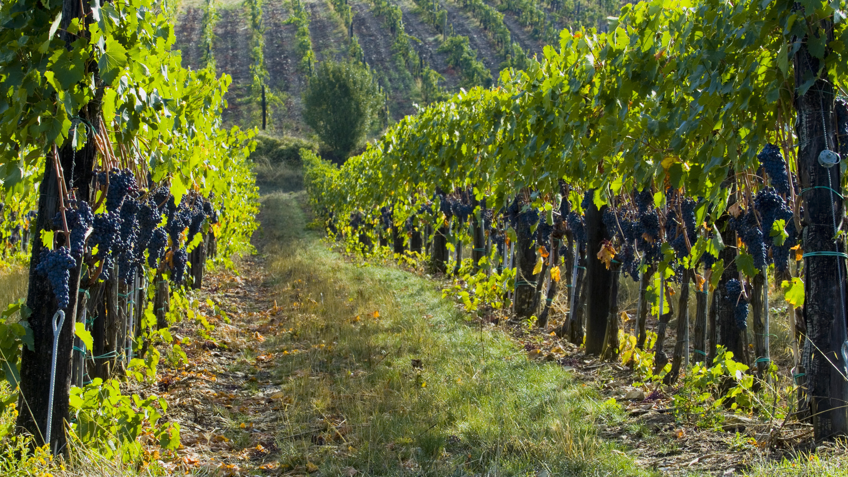
Conclusion
Unfortunately, many are not “workers for the Lord”
Matthew 15:8
Our talk talks and
Our walk talks,
But our walk talks
More than our talk talks!
Richie Thetford www.thetfordcountry.com

