Slide 1
God’s People are Special!
Leviticus 20:26
Patriarchal Age
Mosaical Age
Christian Age

Slide 2
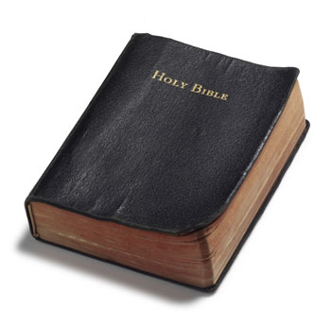
The Call of Abraham
Abraham was special
Genesis 12:1-3
Severed from his country, family
Exodus 8:20
Exodus 19:4-5
Leviticus 20:8, 22, 24, 26

Slide 3
Israel – A Separate People
Israel to avoid sin
Leviticus 20:1-25
Sin was common for the Canaanites
“I have separated you”
They became rebellious
Fell into Assyrian captivity (722 B.C.)
Fell into Babylonian captivity (587 B.C.)

Slide 4
Christians Are to be Separate
To be severed, separate, and special
1 Peter 2:5, 9
“a chosen generation”
Christians are set apart by the word
John 17:17

Slide 5
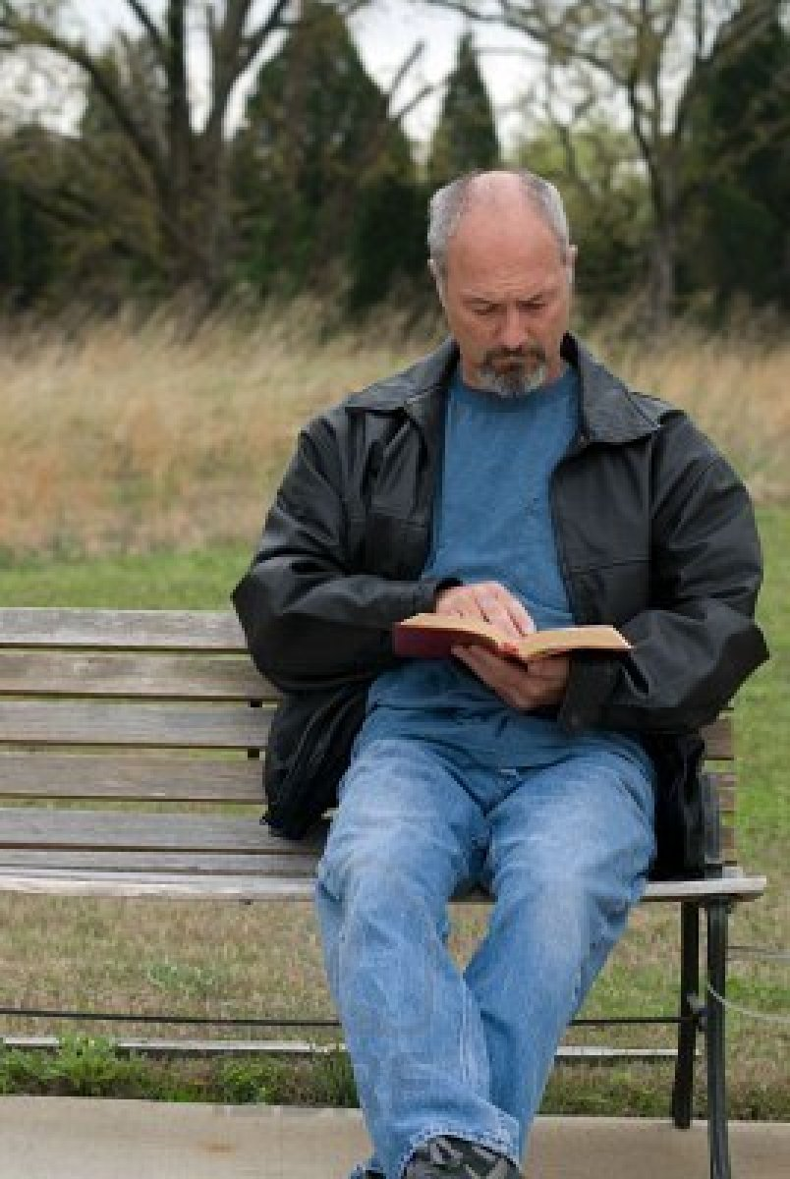
Christians Are to be Separate
Uniqueness of being a Christian:
Our name
Acts 11:26
Our creed
Matthew 15:8-9
2 Timothy 3:16-17
Jude 3

Slide 6
Christians Are to be Separate
Uniqueness of being a Christian:
Our attitude
1 Peter 2:11-12
2 Corinthians 6:17-18
Our organization
Philippians 1:1
Our worship
2 John 9

Slide 7
Christians Are to be Separate
Uniqueness of being a Christian:
Our teaching
Acts 2:38
Acts 22:16
1 Peter 3:21
Romans 6:3-4
Our unity
1 Corinthians 1:10
“Let your light so shine before men, that they may see your good works and glorify your Father in heaven.”
Matthew 5:16

